Slide 1
SIGNAL DENOISING USING WAVELET TRANSFORM
Submitted by
Prashant Ayitapu - (BL.EN.U4EAC21052)
Raja Karthikeya - (BL.EN.U4EAC21054)
Ramu Keerthana P- (BL.EN.U4EAC21055)
Satvik Raghav - (BL.EN.U4EAC21065)

Slide 2
Introduction
Wavelet transform is a mathematical transform that decomposes a signal into different frequency components with varying resolutions.
Unlike the Fourier transform, which provides a fixed-frequency resolution across the entire signal, the wavelet transform allows for adaptive time-frequency analysis.
It achieves this by using wavelet functions, which are scaled and translated versions of a mother wavelet.
The wavelet transform decomposes a signal into a set of coefficients that represent the contribution of different wavelet functions at different scales and positions.
The coefficients obtained from the wavelet transform can be divided into two types:
1. Approximation coefficients
2. Detail coefficients

Slide 4
Block Diagram
AUDIO
(input)
Wavelet transform
(Daubechies4)
Low pass filter
Wavelet
Reconstruction
Speaker
(Output)
Σ
Noise
Sin(2πft)
f=20kHz)

Slide 5
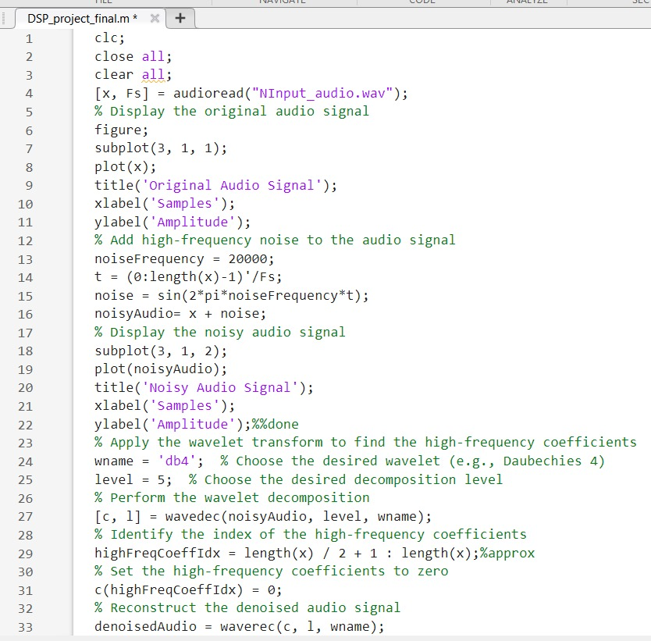
Code:

Slide 6
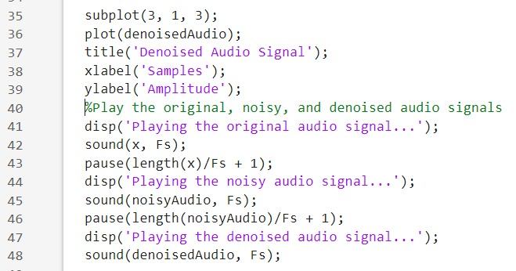
Code contd.

Slide 7
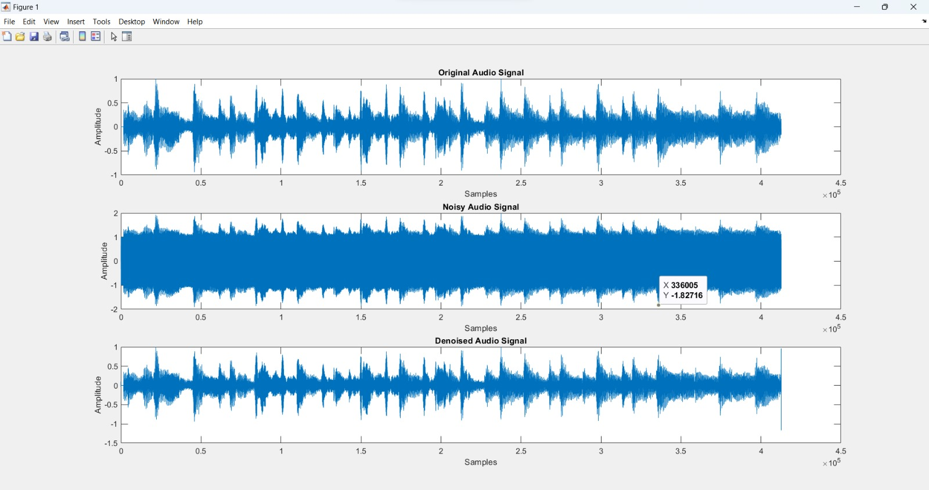
Results

Slide 8
Inferences
In this project we have added high frequency noise to a input signal and applied wavelet transform to obtain the high frequency and low frequency components.We have forced the high frequency components to become zero and applied inverse wavelet transform to obtain the denoised signal.
In summary, wavelet transform-based denoising offers an efficient and flexible approach for noise reduction in signals, balancing noise suppression with the preservation of essential signal features. Its ability to capture localized details and adapt to the signal's frequency content makes it a valuable tool for a wide range of applications, including audio processing, image denoising, and biomedical signal analysis.

